Slide 1

DRUMKIT Course: CSD 2214_4

Slide 2
About
DrumKit is a business-oriented web application wherein users can learn and play a drum virtually by pressing the keys from keyboard or by mouse-click. It generates sounds according to the sound notes that are clicked. Also, users can register themselves on the website to access it. Additionally, they can get to know about famous drummers. Moreover, if they need any hep, they can talk to our virtual assistant (chatbot).

Slide 3
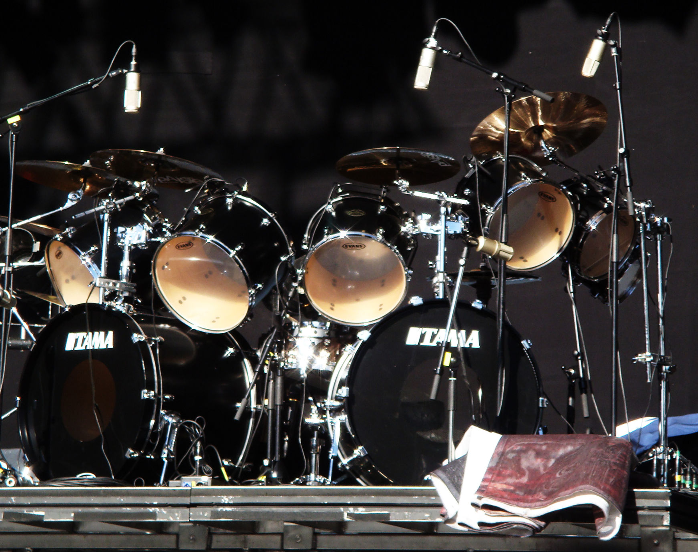
LogIn/SignUp Pages
This Photo by Unknown Author is licensed under CC BY-SA

Slide 4
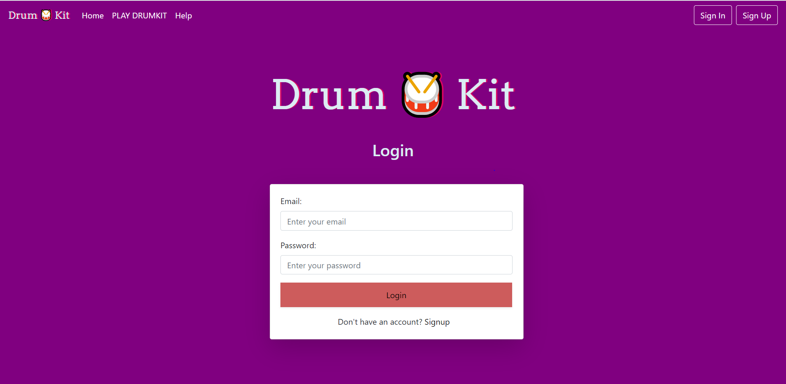

Slide 5
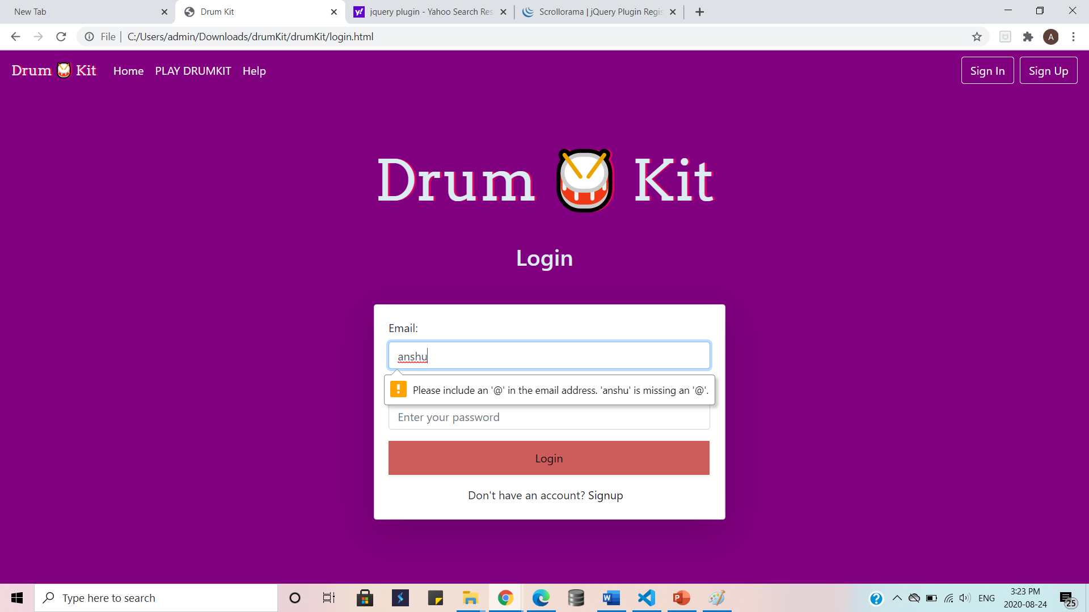
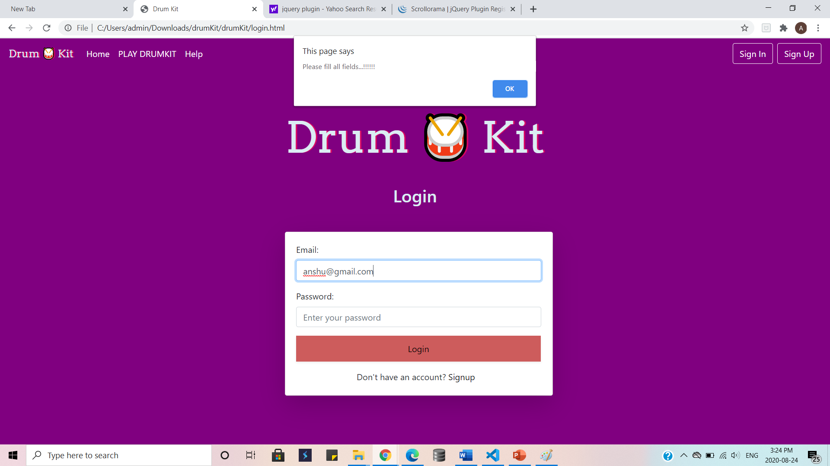
JQuery Validation for Credentials
JQuery validation for all fields

Slide 6
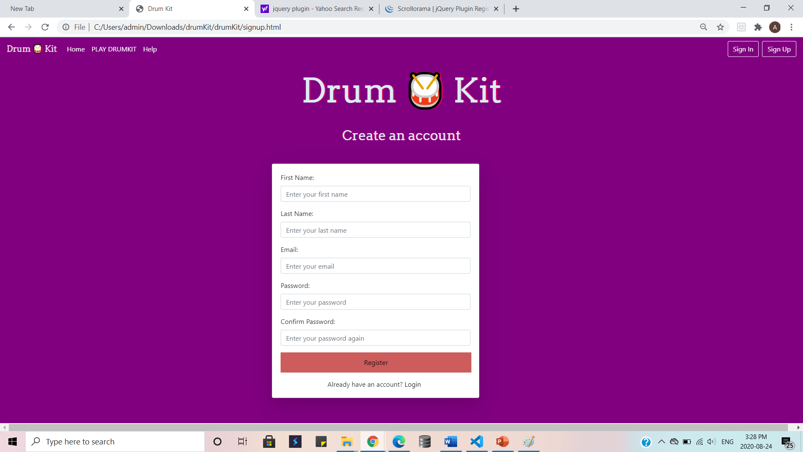

Slide 7
HomePage includes JQuery Plugins for various effects like fadein/fadeout, scrollup/scrolldown, shuffle, etc.
This Photo by Unknown Author is licensed under CC BY-SA

Slide 8
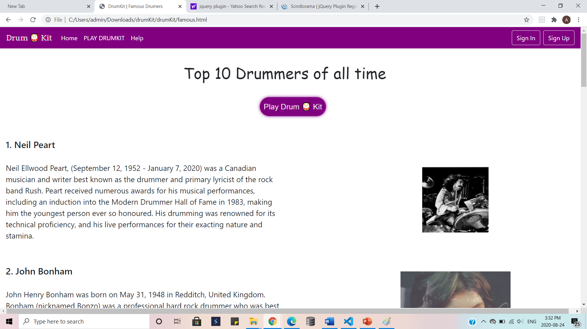

Slide 9
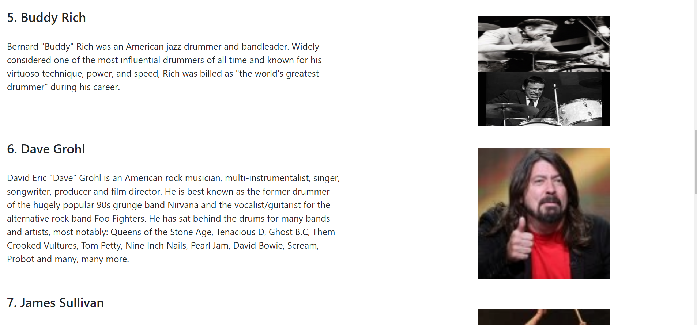

Slide 10
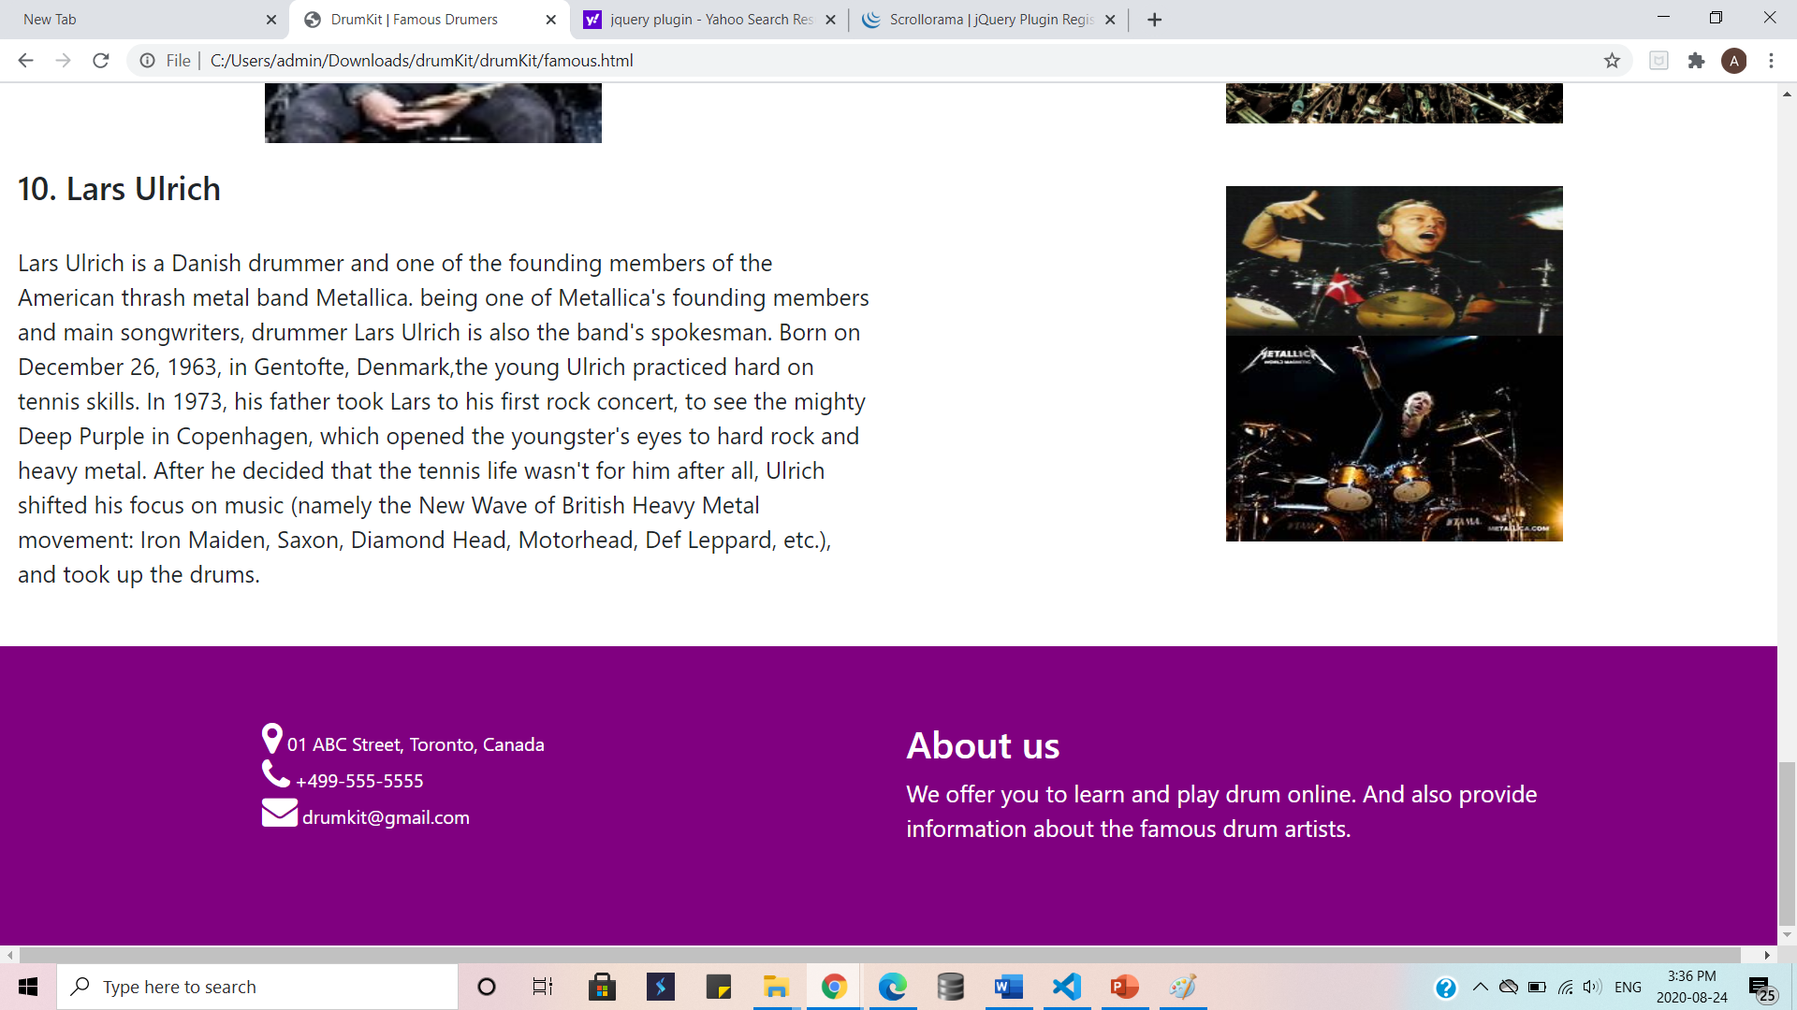

Slide 11
DrumKit Page includes keys to play drum and produce various drum sounds, using javascript.
This Photo by Unknown Author is licensed under CC BY-SA

Slide 12
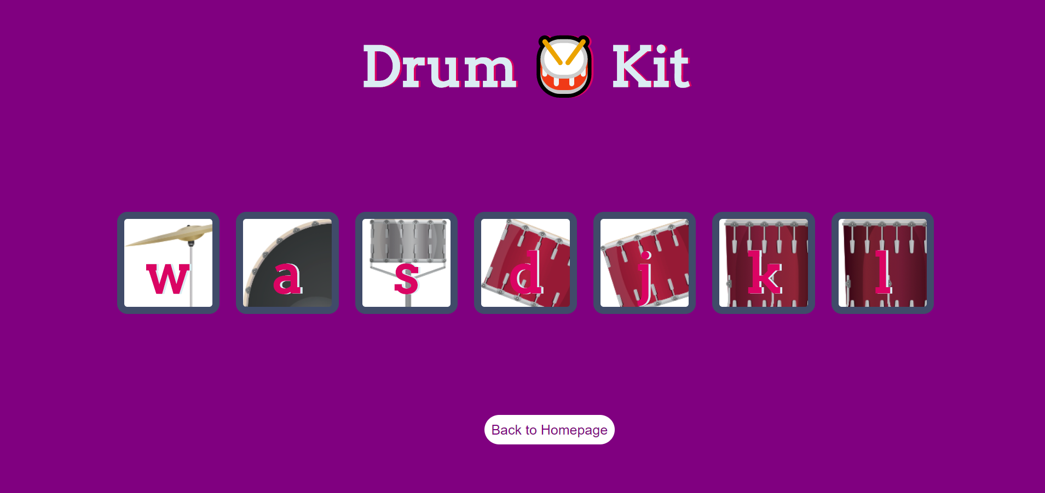

Slide 13
Help Page user can speak with our virtual assistant(chatbot) in this page and in revert user will be able to hear and see the response by chatbot, (built in javascript).
This Photo by Unknown Author is licensed under CC BY-SA

Slide 14
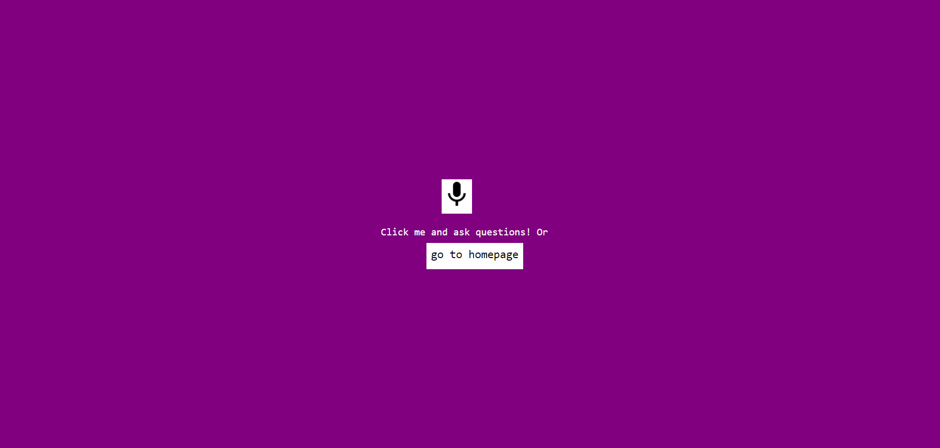

Slide 15
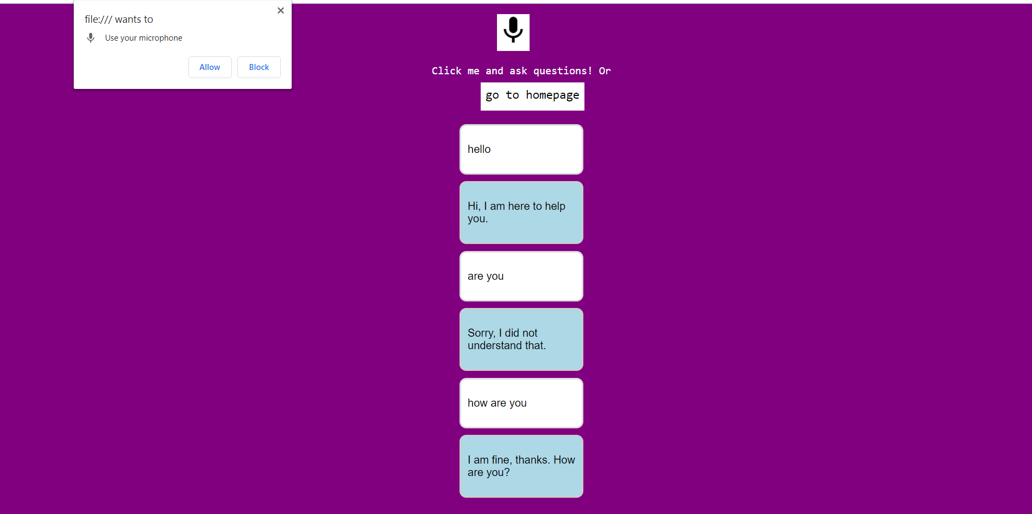

Slide 16
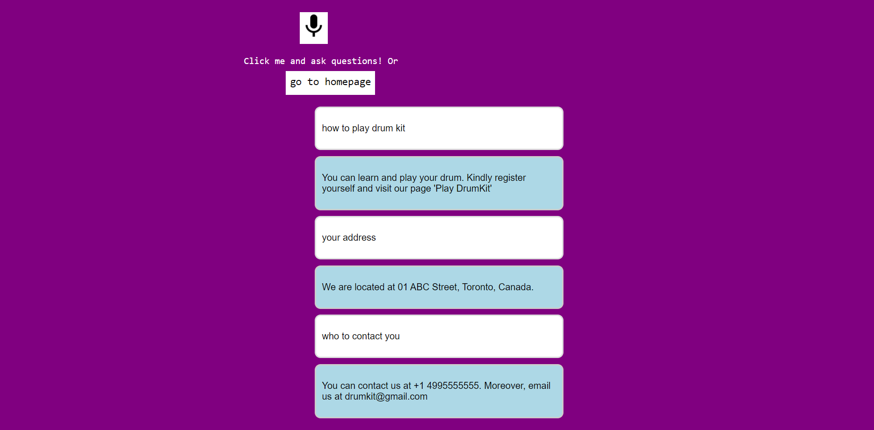

Slide 17
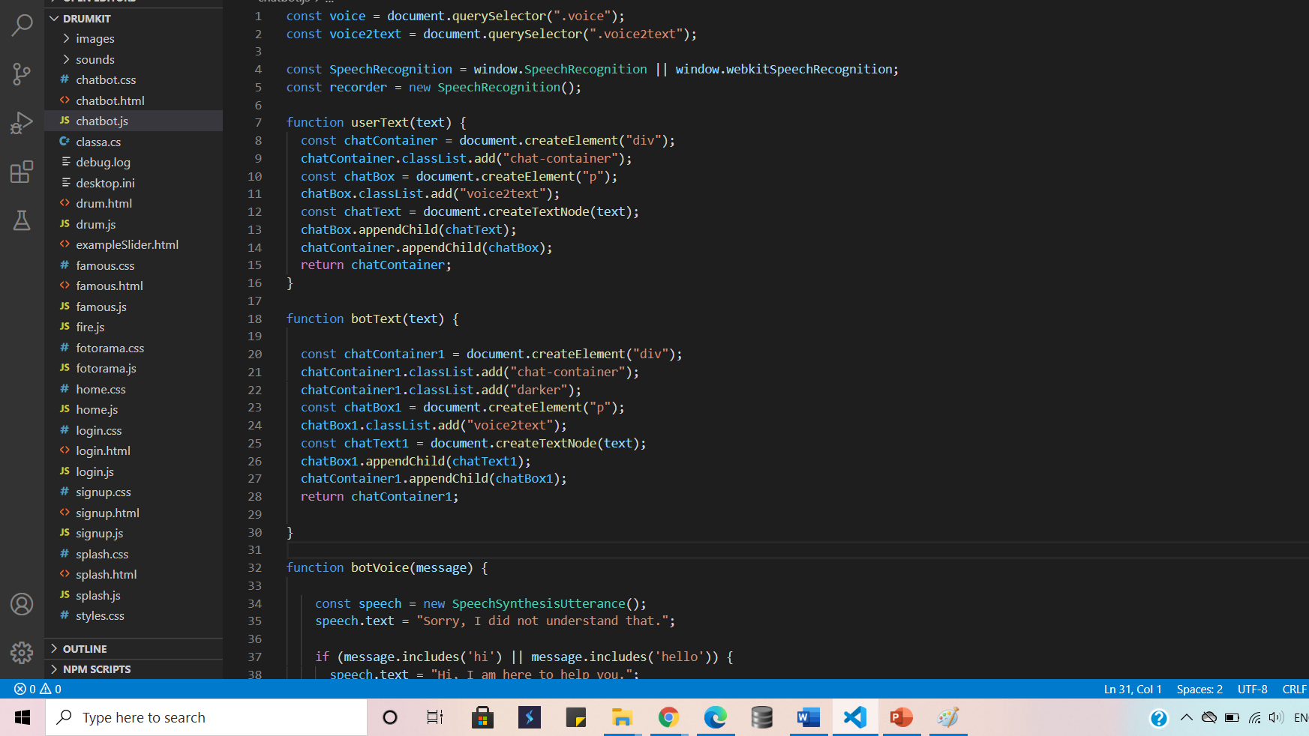
Implementation
of chatbot

Slide 18
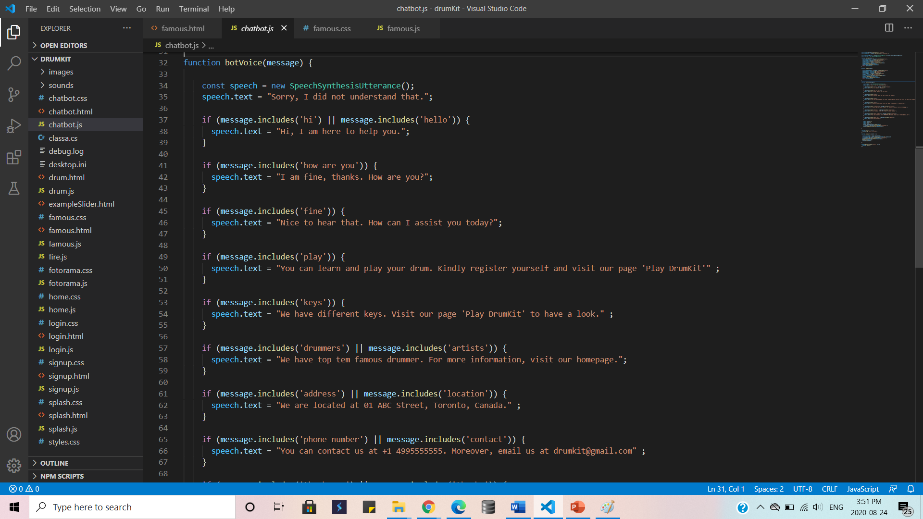
Continued..

Slide 19
Thank you

